Slide 1
Network
Introduction to
Computer Networks
Slide Source: Cisco Networking

Slide 2


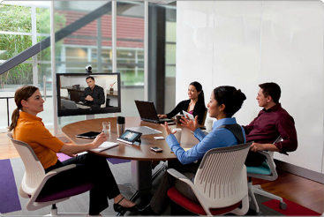
Networking Today
Network has no boundary and supports the way we:
Learn
Communicate
Work
Play

Slide 3
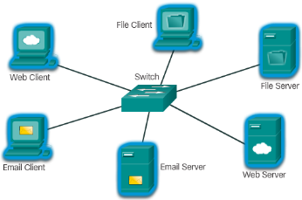
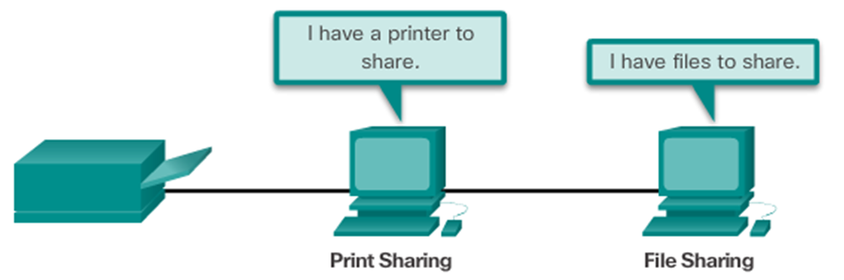
Providing Resources in a Network
Networks of Many Sizes
Small Home / Office Networks
Medium to Large Networks
World Wide Network
Clients and Servers
Clients request and display information
Servers provide information to other devices on the network
Peer-to-Peer
Computers can be both server and client at the same time.
What are the advantages?
What are the disadvantages?

Slide 4
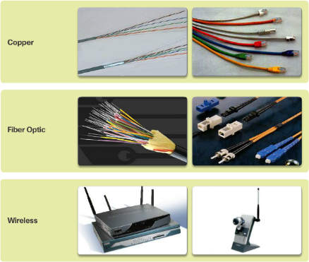
Network Components
End Devices
Either the source or destination of a message
Name some end devices
Intermediary Network Devices
Connect multiple individual networks to form an internetwork
Connect the individual end devices to the network
Ensure data flows across the network
Provide connectivity
Network Media
Provide the pathway for data transmission
Interconnect devices
Name the three types of media

Slide 5






Network Components
Network Representations
What do the symbols represent?
Topology Diagrams
Physical
Logical

Slide 6
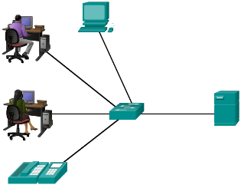
LANs and WANs
Local Area Networks
Spans across small geographical area
Interconnects end devices
Administrated by a single organization
Provide high speed bandwidth to internal devices
WAN Area Networks
Interconnects LAN
Administrated by multiple service providers
Provide slower speed links between LANS
Can you name more network types?

Slide 7
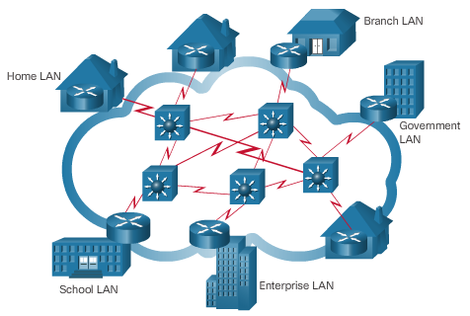
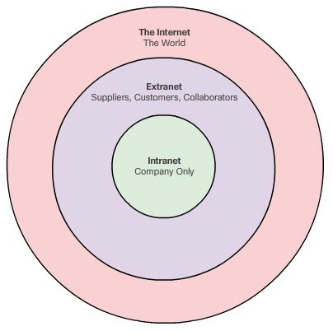
The Internet, Intranets, and Extranets
The Internet
Worldwide collection of interconnected networks
Not owned by any individual or group
Intranets and Extranets

Slide 8
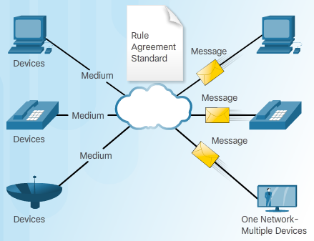
The Network as a Platform Converged Networks
Traditional Separate Networks
Each network with its own rules and
The Converging Network
Capable of delivering data, voice, and video over the same network infrastructure

Slide 9
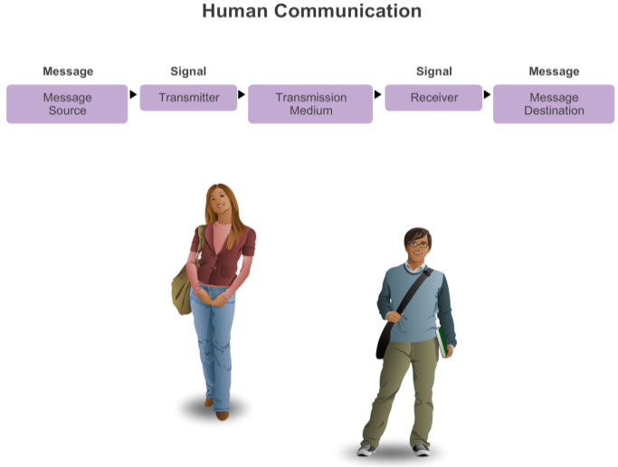
What is Communication?

Slide 10
Establishing the Rules
An identified sender and receiver
Agreed upon method of communicating (face-to-face, telephone, letter, photograph)
Common language and grammar
Speed and timing of delivery
Confirmation or acknowledgment requirements

Slide 11
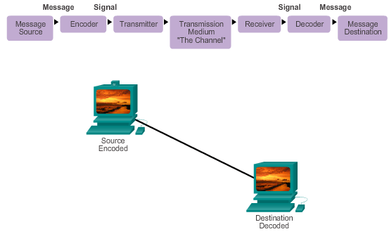
Message Encoding

Slide 12
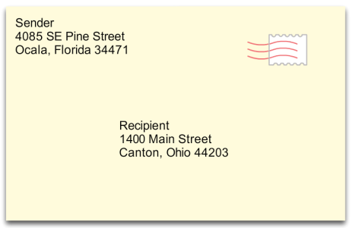
Message Formatting and Encapsulation
Example: Personal letter contains the following elements:
Identifier of the recipient’s location
Identifier of the sender’s location
Salutation or greeting
Recipient identifier
The message content
Source identifier
End of message indicator

Slide 13
Message Size
An overview of the segmenting process:
The size restrictions of frames require the source host to break a long message into individual pieces (or segments) that meet both the minimum and maximum size requirements.
Each segment is encapsulated in a separate frame with the address information, and is sent over the network.
At the receiving host, the messages are de-encapsulated and put back together to be processed and interpreted.

Slide 14
Message Timing
Access Method
Flow Control
Response Timeout

Slide 15
Network Protocols
How the message is formatted or structured
The process by which networking devices share information about pathways with other networks
How and when error and system messages are passed between devices
The setup and termination of data transfer sessions

Slide 16
Interaction of Protocols
Application Protocol – Hypertext Transfer Protocol (HTTP)
Transport Protocol – Transmission Control Protocol (TCP)
Internet Protocol – Internet Protocol (IP)
Network Access Protocols – Data link & physical layers

Slide 17
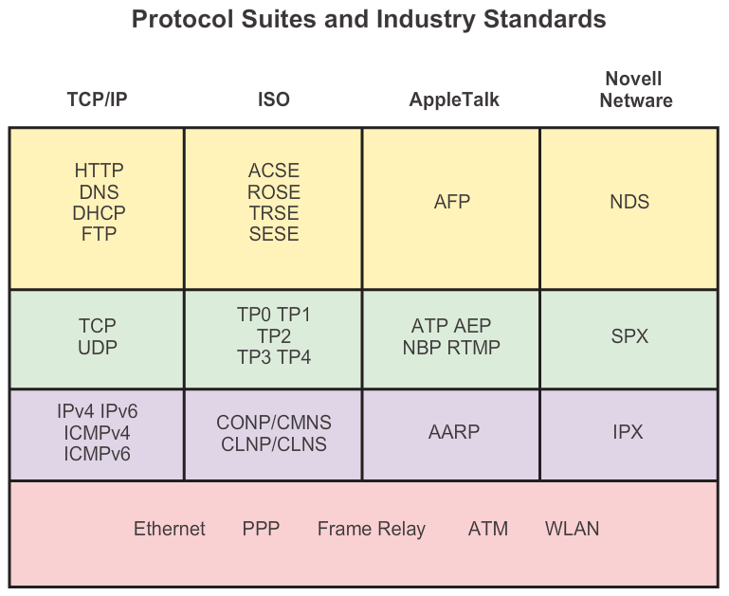
Protocol Suites and Industry Standards

Slide 18
Creation of Internet, Development of TCP/IP
The first packet switching network and predecessor to today’s Internet was the Advanced Research Projects Agency Network (ARPANET), which came to life in 1969 by connecting mainframe computers at four locations.
ARPANET was funded by the U.S. Department of Defense for use by universities and research laboratories. Bolt, Beranek and Newman (BBN) was the contractor that did much of the initial development of the ARPANET, including creating the first router known as an Interface Message Processor (IMP).
In 1973, Robert Kahn and Vinton Cerf began work on TCP to develop the next generation of the ARPANET. TCP was designed to replace ARPANET’s current Network Control Program (NCP).
In 1978, TCP was divided into two protocols: TCP and IP. Later, other protocols were added to the TCP/IP suite of protocols including Telnet, FTP, DNS, and many others.

Slide 19
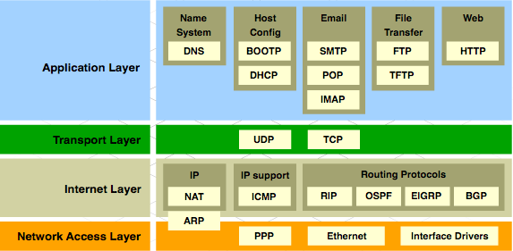
TCP/IP Protocol Suite and Communication

Slide 20
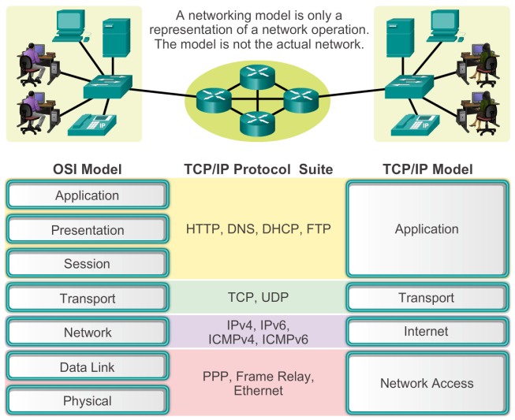
Benefits of Using a Layered Model

Slide 21
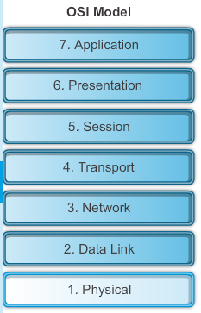
The OSI Reference Model

Slide 22
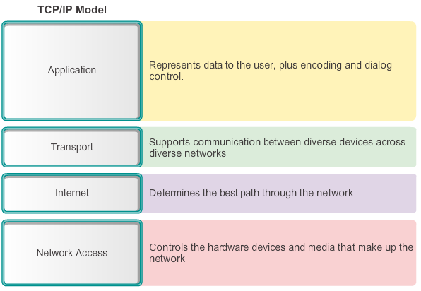
The TCP/IP Reference Model
Notes:
3.2.4.3 The TCP/IP Protocol Model

Slide 23
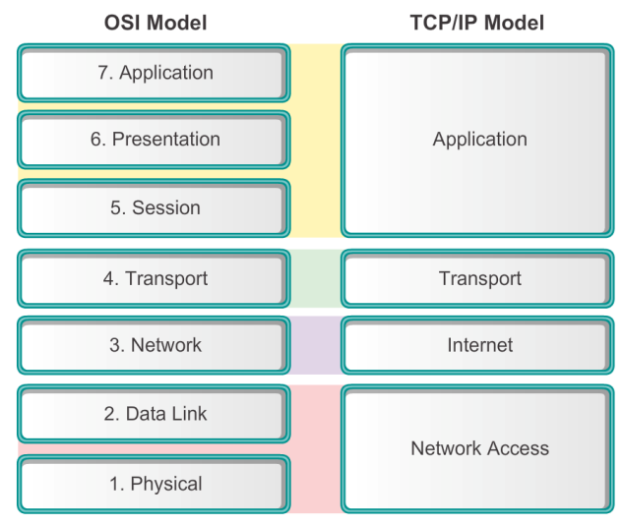
Comparing the OSI and TCP/IP Models

Slide 24
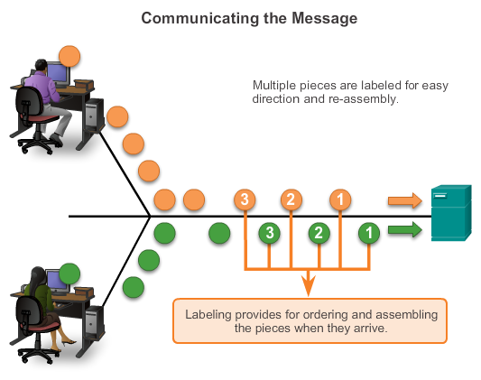
Communicating the Messages
Segmenting message benefits
Different conversations can be interleaved
Increased reliability of network communications
Segmenting message disadvantage
Increased level of complexity

Slide 25
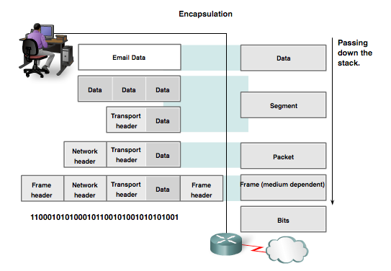
Protocol Data Units (PDUs)
Data
Segment
Packet
Frame
Bits

Slide 26
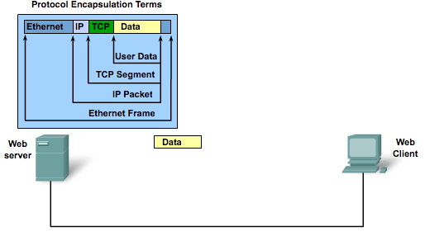
Protocol Encapsulation

Slide 27
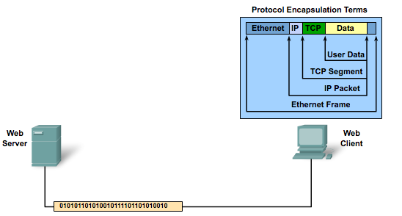
Protocol De-encapsulation

Slide 28
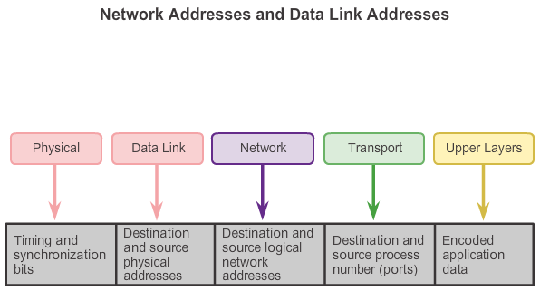
Accessing Local Resources
Notes:
3.3.2.1 Network Addresses and Data Link addresses

Slide 29
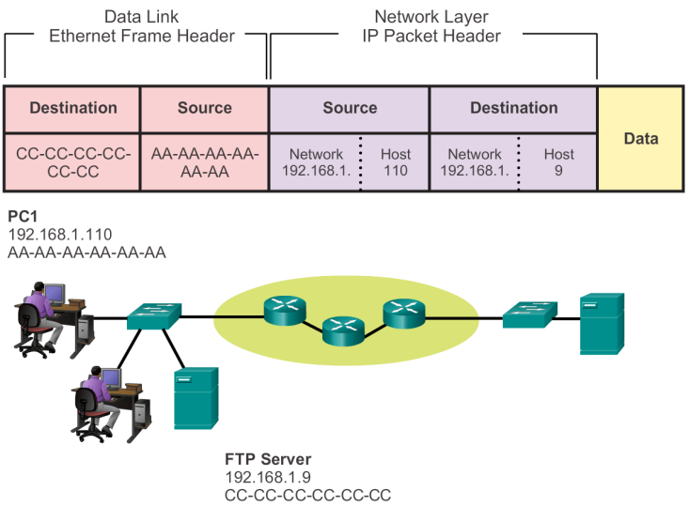

Communicating with Device / Same Network

Slide 30


MAC and IP Addresses
R1
192.168.1.1
11-11-11-11-11-11
ARP
Request
PC1
192.168.1.110
AA-AA-AA-AA-AA-AA
S1
R1
PC2
192.168.1.111
BB-BB-BB-BB-BB-BB
FTP Server
192.168.1.9
CC-CC-CC-CC-CC-CC

Slide 31
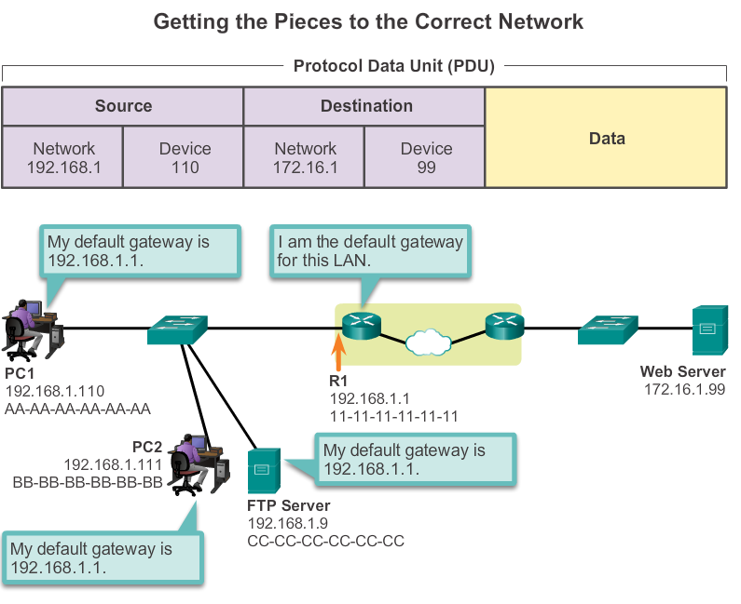
Default Gateway

Slide 32
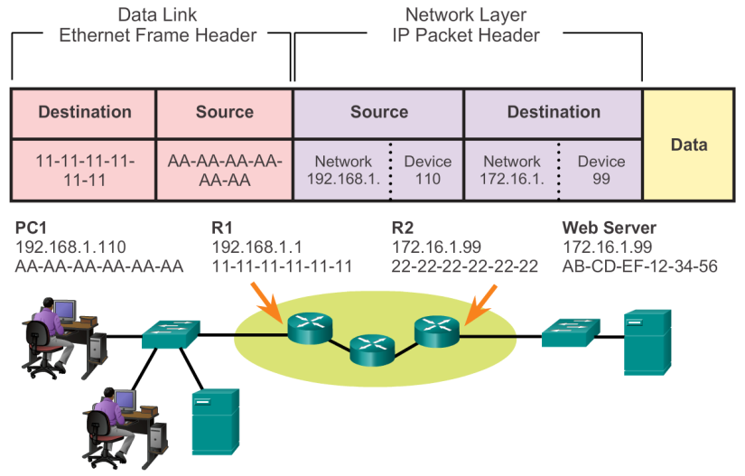
Communicating Device / Remote Network

Slide 33
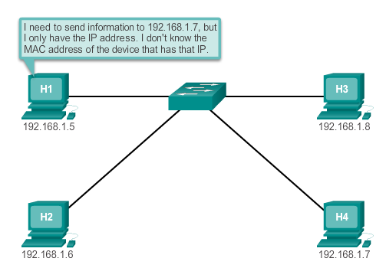
Introduction to ARP

Slide 34
ARP Functions/Operation
ARP Table
Used to find the data link layer address that is mapped to the destination IPv4 address.
As a node receives frames from the media, it records the source IP and MAC address as a mapping in the ARP table.
ARP Request
Layer 2 broadcast to all devices on the Ethernet LAN.
The node that matches the IP address in the broadcast will reply.
If no device responds to the ARP request, the packet is dropped because a frame cannot be created.
Note: Static map entries can be entered in an ARP table, but this is rarely done.

Slide 35
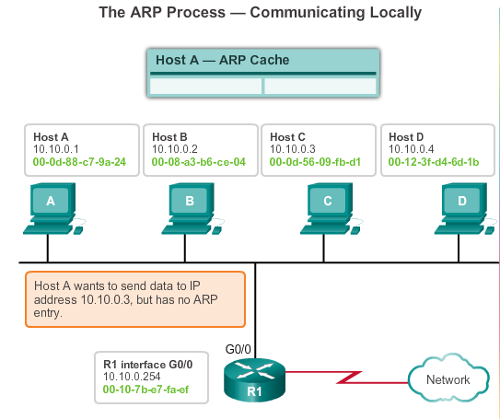
ARP Operation

Slide 36
Physical Layer Fundamental Principles
Media | Physical Components | Frame Encoding Technique | Signalling Method
Copper Cable | UTP Coaxial Connectors NICs Ports Interfaces | Manchester Encoding Non-Return to Zero (NRZ) techniques 4B/5B codes are used with Multi-Level Transition Level 3 (MLT-3) signaling 8B/10B PAM5 | Changes in the electromagnetic field Intensity of the electromagnetic field Phase of the electromagnetic wave
Fiber Optic Cable | Single-mode Fiber Multimode Fiber Connectors NICs Interfaces Lasers and LEDs Photoreceptors | Pulses of light Wavelength multiplexing using different colors | A pulse equals 1. No pulse is 0.
Wireless Media | Access Points NICs Radio Antennae | DSSS (direct-sequence spread-spectrum) OFDM (orthogonal frequency division multiplexing) | Radio waves

Slide 37
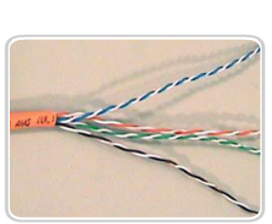
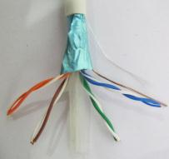

Copper Cabling Copper Media
Unshielded Twisted Pair (UTP) Cable
Shielded Twisted Pair (STP) Cable
Coaxial Cable

Slide 38
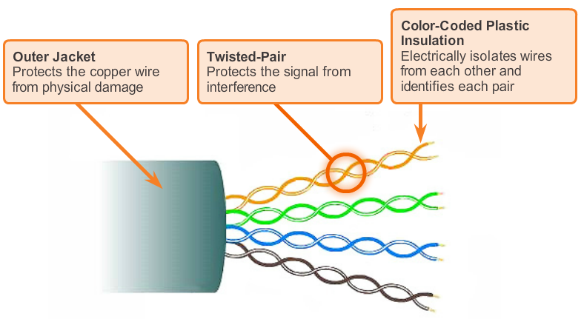
Copper Cabling UTP Cable

Slide 39
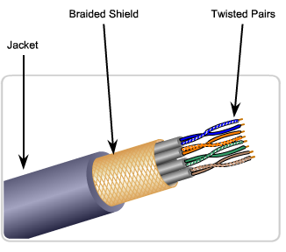
Copper Cabling STP Cable
Braided or Foil Shield
Foil Shields

Slide 40
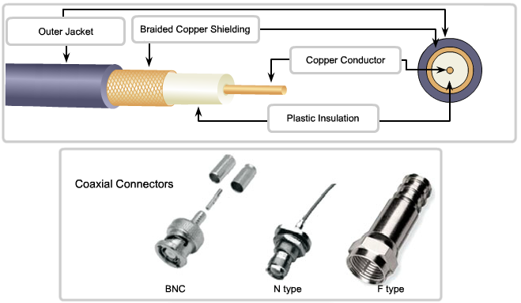
Copper Cabling Coaxial Cable

Slide 41
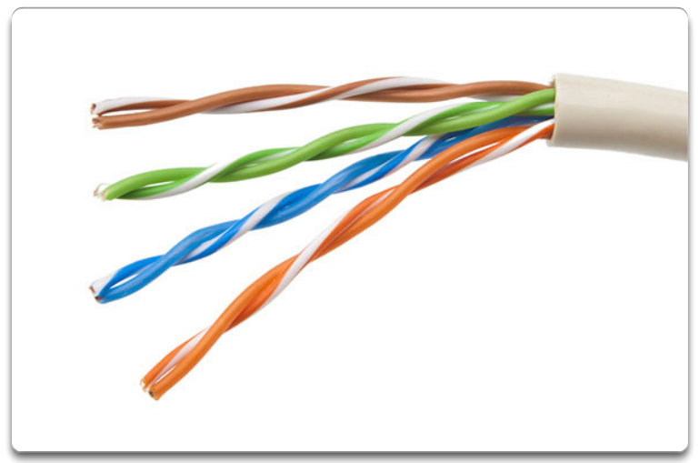
UTP Cabling
UTP cable does not use shielding to counter the effects of EMI and RFI. Instead, cable designers have discovered that they can limit the negative effect of crosstalk by:
Cancellation
Varying the number of twists per wire pair

Slide 42
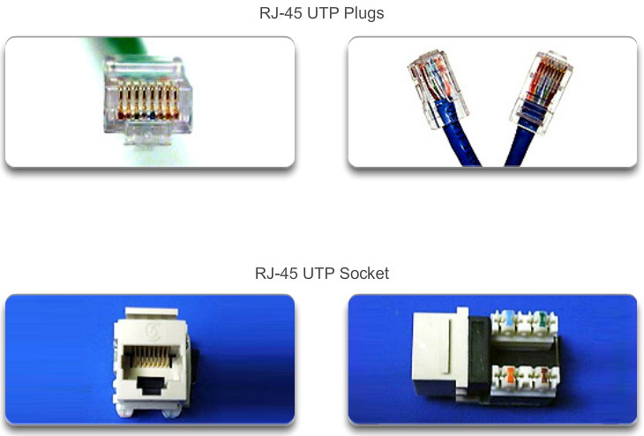
UTP Cabling UTP Connectors

Slide 43
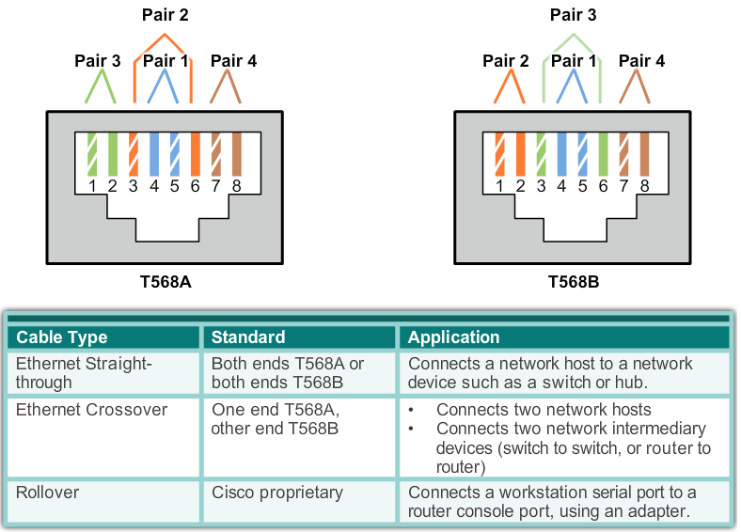
UTP Cabling Types of UTP Cable

Slide 44
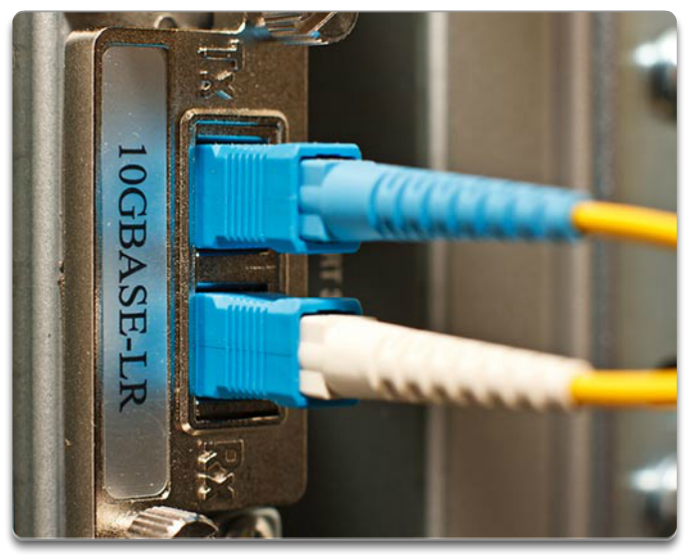
Fiber Optic Cabling Properties of Fiber Optic Cabling
Fiber-optic cabling is now being used in four types of industry:
Enterprise Networks
Fiber-to-the-home (FTTH) and Access Networks
Long-Haul Networks
Submarine Networks

Slide 45
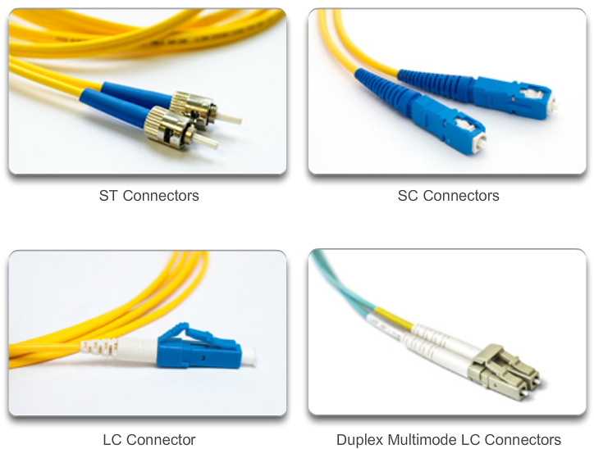
Fiber Optic Cabling Network Fiber Connectors

Slide 46
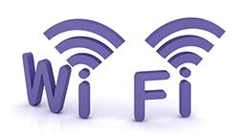


Types of Wireless Media
 | IEEE 802.11 standards Commonly referred to as Wi-Fi. Uses CSMA/CA Variations include: 802.11a: 54 Mbps, 5 GHz 802.11b: 11 Mbps, 2.4 GHz 802.11g: 54 Mbps, 2.4 GHz 802.11n: 600 Mbps, 2.4 and 5 GHz 802.11ac: 1 Gbps, 5 GHz 802.11ad: 7 Gbps, 2.4 GHz, 5 GHz, and 60 GHz
 | IEEE 802.15 standard Supports speeds up to 3 Mb/s Provides device pairing over distances from 1 to 100 meters.
 | IEEE 802.16 standard Provides speeds up to 1 Gbps Uses a point-to-multipoint topology to provide wireless broadband access.

Slide 47
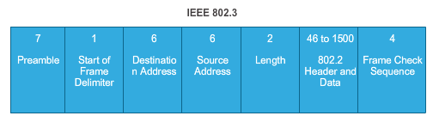
Introduction to the Ethernet Frame
Preamble and Start Frame Delimiter Fields –
Used for synchronization between the sending and receiving devices.
Length/Type Field –
Defines the exact length of the frame's data field; describes which protocol is implemented.
Data and Pad Fields –
Contains the encapsulated data from a higher layer, an IPv4 packet.

Slide 48
Introduction to the Ethernet Frame (cont.)
Frame Check Sequence Field
Used to detect errors in a frame with cyclic redundancy check (4 bytes); if calculations match at source and receiver, no error occurred.

Slide 49
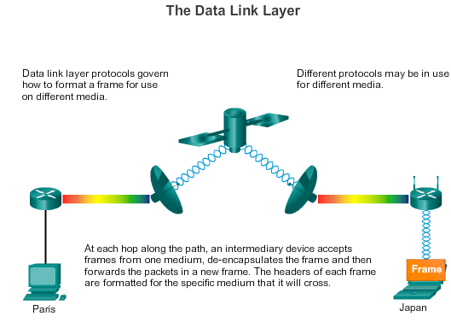
End-to-End Connectivity, MAC, and IP (cont.)
Notes:
5.1.4.2 End-to-End Connectivity, MAC, and IP (cont.)

Slide 50
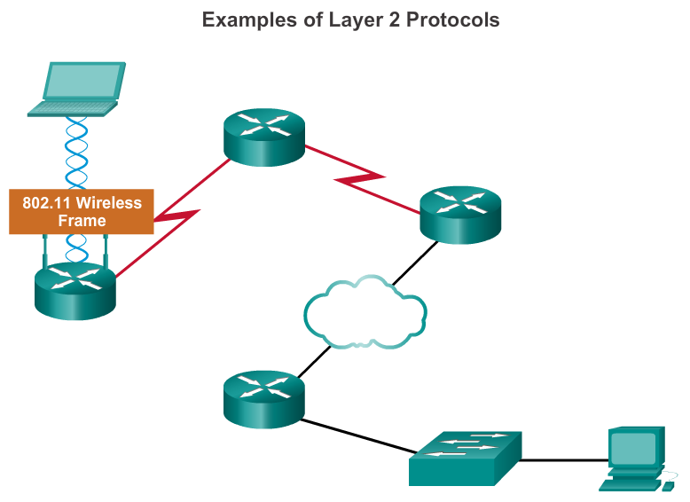
LAN and WAN Frames
Notes:
4.4.4.5 LAN and WAN Frames

Slide 51
The Network Layer
The network layer, or OSI Layer 3, provides services to allow end devices to exchange data across the network. To accomplish this end-to-end transport, the network layer uses four basic processes:
Addressing end devices
Encapsulation
Routing
De-encapsulating
Notes:
6.1.1.1 The Network Layer

Slide 52
Network Layer Protocols
Common network layer protocols include:
IP version 4 (IPv4)
IP version 6 (IPv6)
Legacy network layer protocols include:
Novell Internetwork Packet Exchange (IPX)
AppleTalk
Connectionless Network Service (CLNS/DECNet)
Notes:
6.1.1.2 Network Layer Protocols

Slide 53
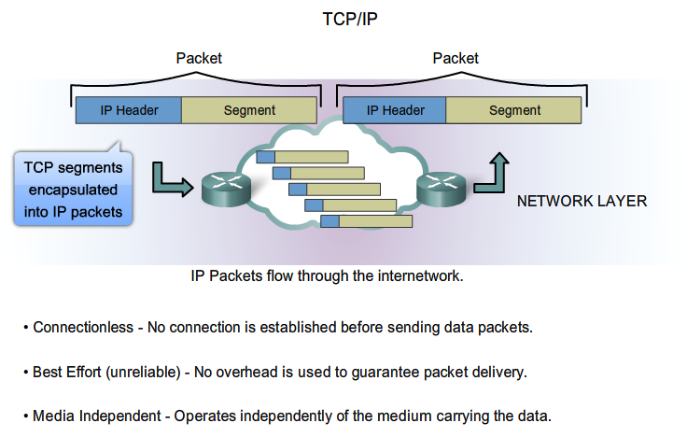
IP Components

Slide 54
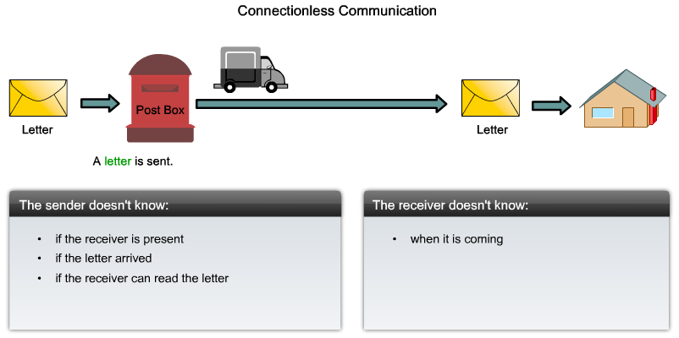
IP - Connectionless

Slide 55
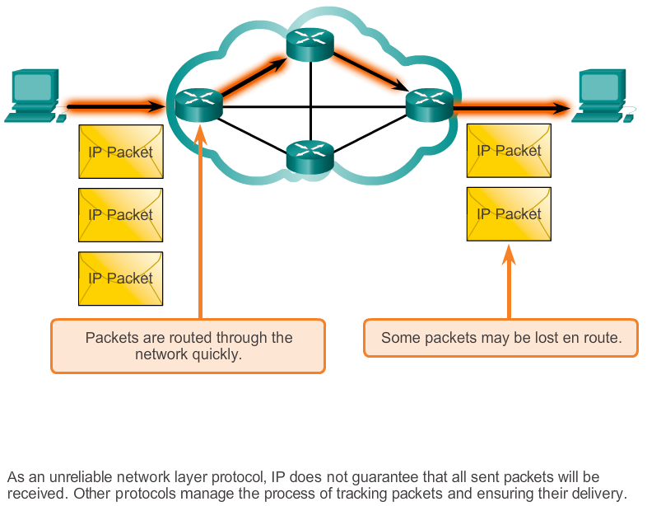
Best Effort Delivery

Slide 56
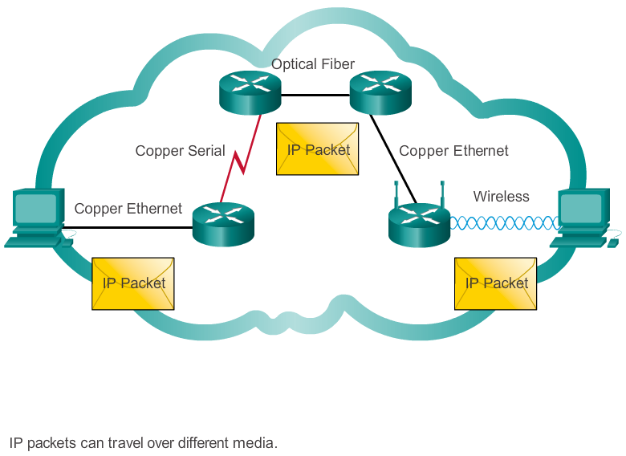
IP – Media Independent

Slide 57
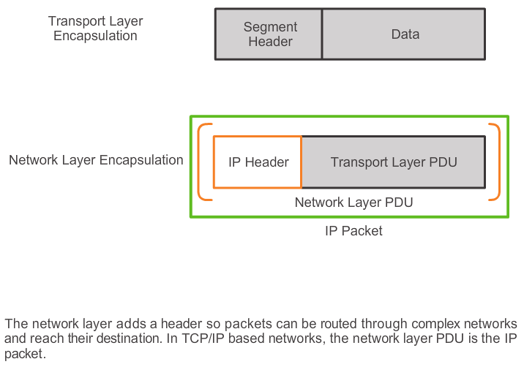
IPv4 Packet Encapsulating IP

Slide 58
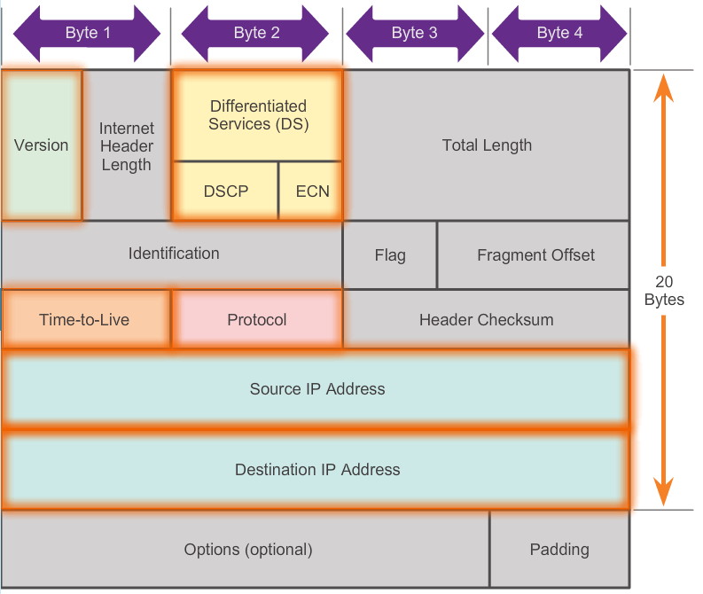
IPv4 Packet IPv4 Packet Header
Contents of the IPv4 packet header

Slide 59
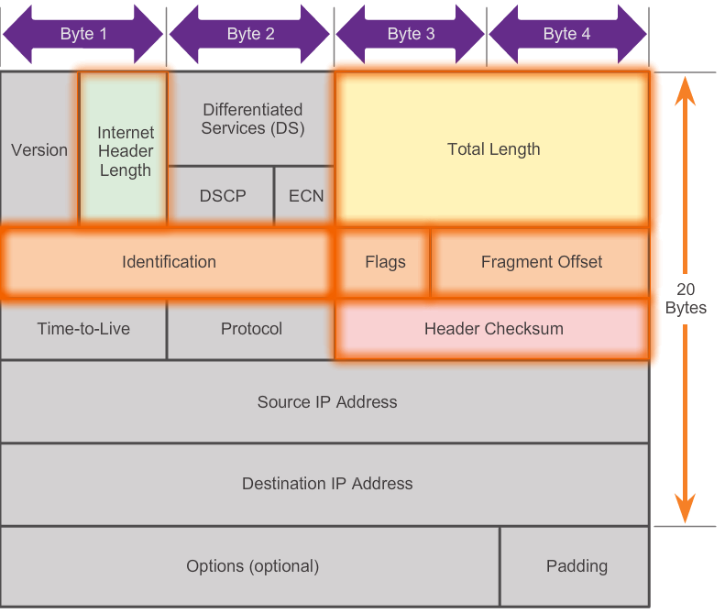
IPv4 Packet IPv4 Header Fields
Contents of the IPv4 header fields

Slide 60
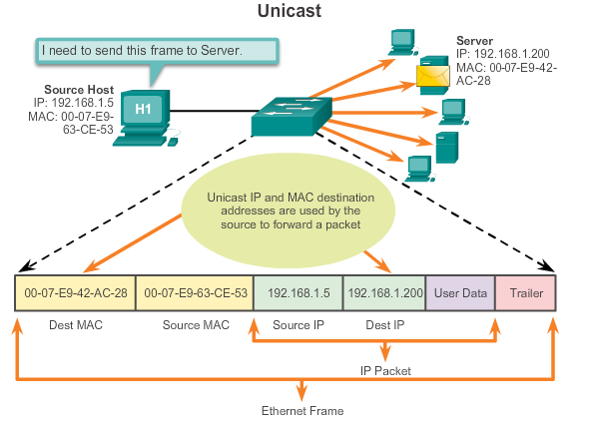
Unicast Address

Slide 61
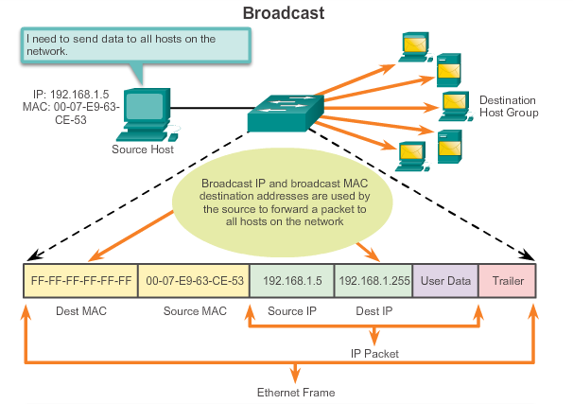
Broadcast MAC Address

Slide 62

Multicast Address
Multicast MAC address is a special value that begins with 01-00-5E in hexadecimal
Range of IPV4 multicast addresses is 224.0.0.0 to 239.255.255.255

Slide 63

Sample IPv4 Headers in Packet Tracer

Slide 64

Limitations of IPv4
IP Address depletion
Internet routing table expansion
Lack of end-to-end connectivity
Notes:
6.1.4.1 Limitations of IPv4

Slide 65
IPv6
Increased address space
Improved packet handling
Eliminates the need for NAT
Integrated security
4 billion IPv4 addresses 4,000,000,000
340 undecillion IPv6 addresses 340,000,000,000,000,000,000,000,000,000,000,000,000

Slide 66

Encapsulating IPv6

Slide 67
IPv6 Packet Header
Byte 1
Byte 2
Byte 3
Byte 4
Version | Traffic Class |  | Flow Label
Payload Length |  |  |  | Next Header | Hop Limit
Source IP Address
Destination IP Address

